Slide 1
HUMAN RESOURCE DEVELOPMENT UNIT-2

Slide 2
POTENTIAL APPRAISAL
Potential appraisal means assessing the potential; that is, the highest level of work a person could ultimately be expected to perform without being overstretched.
It is a systematic evaluation process used by organizations to assess the likelihood of employees to grow, develop, and succeed in future roles within the company. It focuses on identifying employees' strengths, weaknesses, skills, and competencies to determine their potential for advancement and to align individual talents with organizational objectives.

Slide 3
NEED OF POTENTIAL APPRAISAL
Identifying Future Leaders
Succession Planning
Talent Development
Retention and Engagement
Strategic Alignment
Competitive Advantage
Motivation and Morale
Resource Optimization
Innovation and Adaptability
Performance Improvement

Slide 4
OBJECTIVES
Identify high-potential employees.
Foster talent development.
Facilitate succession planning.
Align individual potential with organizational goals.
Identify future leaders and key talents early on.
Provide targeted development opportunities.
Enhance workforce planning and resource allocation.

Slide 5
ADVANTAGES
Talent identification for future leadership roles.
Enhanced employee engagement and retention.
Improved succession planning and organizational agility.
Tailored development plans for high-potential individuals.
Encourages proactive talent management and development.
Supports a culture of continuous learning and growth.
Strengthens employee commitment and loyalty.
Promotes a meritocratic work environment based on potential.

Slide 6
DISADVANTAGES
Subjectivity in assessment leading to bias.
Potential demotivation for employees not identified as high-potential.
Resource-intensive process requiring time and effort.
Potential for decreased collaboration and teamwork if competition among employees is fostered.
Risk of creating a hierarchical culture that overlooks non-high-potential employees.
Potential for increased stress and competition among employees.
May lead to resentment or disillusionment if appraisal criteria are not transparent.
Requires effective communication to mitigate negative perceptions and maintain morale.

Slide 7
TRADITIONAL METHODS OF APPRAISAL
Performance Appraisal: Assessing an employee's job performance against predetermined objectives and standards.
Behaviorally Anchored Rating Scales (BARS): Using predetermined behavioral descriptors to rate an employee's performance across specific job-related behaviors or competencies.
Critical Incident Technique (CIT): Documenting specific incidents of effective or ineffective behavior for evaluation purposes, providing concrete examples for performance assessment.
Graphic Rating Scales: Using a scale to rate employees on various performance dimensions, such as communication skills, teamwork, or problem-solving abilities.
Forced Ranking (Rank-and-Yank): Ranking employees against each other based on performance, often leading to the termination or demotion of employees who fall below a certain threshold.
Essay Appraisal: Providing narrative descriptions of an employee's strengths, weaknesses, and areas for improvement, often written by supervisors or managers.
Self-Appraisal: Allowing employees to evaluate their own performance against predetermined criteria, providing insights into their self-awareness and perceptions of their contributions.
Checklist Method: Utilizing a list of performance criteria or behaviors against which the appraiser checks off items that apply to the employee's performance.

Slide 8
MODERN METHODS OF APPRAISAL
Management Assessment: Involves subjective evaluation by managers or supervisors based on their observations, interactions, and professional judgment regarding an employee's potential for future growth and development.
Psychological Testing: Utilizes standardized tests and assessments to measure cognitive abilities, personality traits, leadership potential, and other factors relevant to assessing an individual's potential.
Assessment Centers: Simulate real-life work situations through exercises, simulations, and role-plays to observe and evaluate participants' performance, behavior, and potential in various scenarios.
Succession Planning Reviews: Involves systematic reviews of employees' career aspirations, skills, competencies, and readiness to fill key positions in the organization in the future.
360-Degree Feedback for Development: Gathering feedback from multiple sources, including supervisors, peers, subordinates, and other stakeholders, to assess an individual's strengths, areas for improvement, and potential for growth.

Slide 9
MODERN METHODS OF APPRAISAL
Talent Review Meetings: Structured meetings where senior leaders discuss and evaluate employees' potential, performance, and readiness for future roles, often focusing on high-potential individuals identified through talent assessments.
Career Development Discussions: Engaging in regular discussions between employees and their supervisors or mentors to explore career aspirations, goals, and development opportunities, facilitating the identification of high-potential talent.
Job Enrichment and Rotation: Providing employees with challenging assignments, stretch goals, and opportunities for job rotation to assess their adaptability, learning agility, and potential to take on new responsibilities.
Developmental Assignments: Assigning special projects, task forces, or cross-functional teams to employees to enhance their skills, broaden their experiences, and assess their potential for future leadership roles.
Objective Setting and Review: Collaboratively setting performance and development objectives with employees, then reviewing and assessing their progress towards those objectives over time to gauge their potential for growth and advancement.

Slide 10
PAIRED COMPARISON/FORCED RANKING
The paired comparison method is advantageous because it reduces rater bias by directly comparing individuals against each other rather than against a set standard. However, it can be time-consuming, especially if there are many individuals to evaluate. Additionally, it may not provide detailed feedback on specific competencies or skills.
Here's how it typically works:
1. Selecting Criteria: First, you need to identify the criteria or competencies you want to assess. These could include skills, abilities, personality traits, leadership qualities, etc.
2. Pairing Individuals: Each individual is paired with every other individual in the group. So, if you have n individuals, there will be n(n-1)/2 pairs.
3. Comparison and Ranking: For each pair, raters or evaluators assess which individual they believe possesses the criterion being evaluated to a greater extent. This can be done using rating scales, rankings, or simple judgments.
4. Aggregate Scores: After all pairs have been compared and assessed, aggregate the scores for each individual. This can be done by summing up the number of times an individual was chosen as superior in each comparison.
5. Ranking: Finally, rank the individuals based on their aggregate scores. The individual with the highest score is considered the highest potential, and the ranking descends accordingly.

Slide 11
FOCRED DISTRIBUTION AND FORCED CHOICE
Forced Distribution Method:
Overview: The Forced Distribution method requires evaluators to assign a certain percentage of employees to predefined performance categories, such as "top performers," "average performers," and "low performers."
Implementation: Evaluators are typically given a predetermined distribution curve or percentages to adhere to. For example, they might be required to allocate a certain percentage of employees to each category (e.g., 20% top performers, 70% average performers, and 10% low performers).
Forced Choice Method:
Overview: The Forced Choice method presents evaluators with a series of statements or items, and they must choose which option best describes the employee's behavior or performance.
Implementation: Evaluators are presented with pairs or sets of statements describing different behaviors, skills, or traits, and they must choose the statement that most accurately reflects the employee's behavior. This forces evaluators to make choices and avoids leniency or harshness bias.

Slide 12
FOCRED DISTRIBUTION AND FORCED CHOICE
Forced Distribution Method:
Overview: The Forced Distribution method requires evaluators to assign a certain percentage of employees to predefined performance categories, such as "top performers," "average performers," and "low performers."
Implementation: Evaluators are typically given a predetermined distribution curve or percentages to adhere to. For example, they might be required to allocate a certain percentage of employees to each category (e.g., 20% top performers, 70% average performers, and 10% low performers).
Forced Choice Method:
Overview: The Forced Choice method presents evaluators with a series of statements or items, and they must choose which option best describes the employee's behavior or performance.
Implementation: Evaluators are presented with pairs or sets of statements describing different behaviors, skills, or traits, and they must choose the statement that most accurately reflects the employee's behavior. This forces evaluators to make choices and avoids leniency or harshness bias.

Slide 13
CRITICAL INCIDENTS METHOD
The Critical Incidents Method is a performance appraisal technique that involves collecting and documenting specific examples of employee behavior that demonstrate exceptional performance or areas needing improvement. Here's how it typically works:
1. Identifying Critical Incidents
2. Documenting Incidents:
3. Classification
4. Feedback and Evaluation
5. Performance Appraisal

Slide 14
CRITICAL INCIDENTS METHOD
Example:
Let's say a supervisor observes an employee named Sarah dealing with a difficult customer complaint. Sarah remains calm and empathetic throughout the interaction, actively listens to the customer's concerns, and proposes a satisfactory solution, ultimately resolving the issue to the customer's satisfaction.
The supervisor documents this incident, noting Sarah's effective communication skills, problem-solving ability, and customer service orientation. During Sarah's performance review, this critical incident is discussed, and Sarah receives positive feedback for her exemplary handling of the situation. The incident also serves as evidence supporting a high rating in the areas of communication and customer service on Sarah's performance appraisal.
Overall, the Critical Incidents Method provides a structured approach to performance appraisal, focusing on specific behaviors and outcomes rather than vague impressions or generalizations. It encourages objective evaluation and provides valuable feedback for employee development.

Slide 15
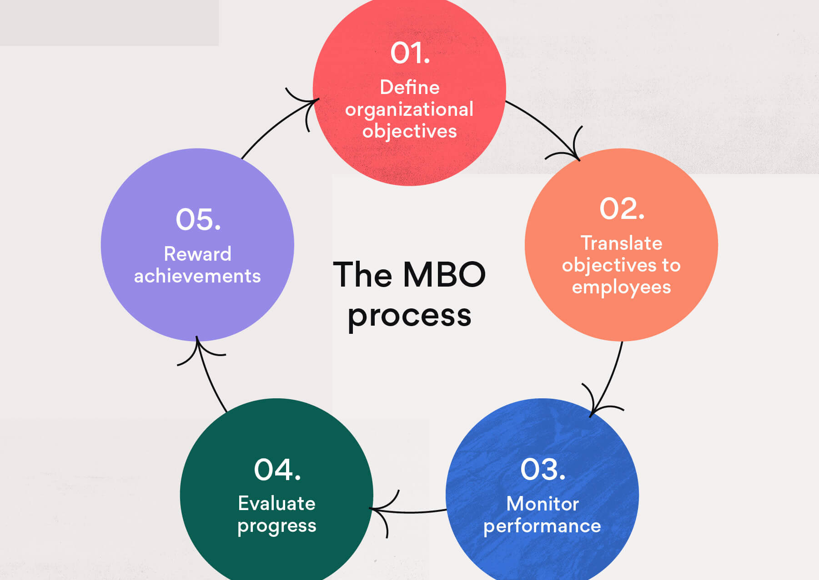
MANAGEMENT BY OBJECTIVE
Management by Objectives (MBO) is a management philosophy and performance appraisal method that emphasizes setting clear, measurable objectives for employees to achieve within a specific time frame.
Goal Setting: The process begins with top-level management defining the organization's overall objectives. These objectives should be specific, measurable, achievable, relevant, and time-bound (SMART).
Cascade of Objectives: Once the organizational objectives are established, they are cascaded down to each level of the organization. Managers work with their teams to set objectives that align with and contribute to the achievement of higher-level objectives.
Agreement and Commitment: Objectives are established through a participatory process involving both managers and employees. This ensures that objectives are understood, agreed upon, and seen as achievable by the employees responsible for their attainment.

Slide 16
MANAGEMENT BY OBJECTIVE
Monitoring Progress: Throughout the performance period, managers monitor progress towards the objectives. Regular check-ins and performance reviews are conducted to assess whether employees are on track to meet their objectives. This may involve reviewing key performance indicators (KPIs) or other metrics related to the objectives.
Feedback and Adjustment: Managers provide ongoing feedback and support to employees to help them achieve their objectives. If necessary, adjustments can be made to objectives or action plans based on changing circumstances or priorities.
Evaluation and Reward: At the end of the performance period, employees are evaluated based on their achievement of objectives. Performance appraisal discussions focus on the extent to which objectives were met, as well as the employee's overall contribution to the organization's success. Rewards, such as salary increases, bonuses, or promotions, may be tied to the achievement of objectives.

Slide 17
BEHAVIOURALLY ANCHORED RATING SCALE(BARS)
A BARS is a rating scale where respondents indicate their agreement or disagreement with each item using a point system. Unlike traditional rating scales, the points in a behaviorally anchored rating scale relate to the respondent’s choice, and the response options range from 1 to 5.
Behaviorally anchored rating scales (BARS) are a type of performance appraisal method that combines elements of both narrative and quantitative rating systems. Unlike traditional rating scales that rely on general traits or characteristics, BARS focuses on specific behaviors that are anchored to numerical ratings.
Keypoints
Based on specific behaviors critical for job success.
Anchors behaviors to numerical ratings.
Provides concrete examples for evaluation.
Offers valid and detailed feedback.
Guides training and development efforts effectively.

Slide 18
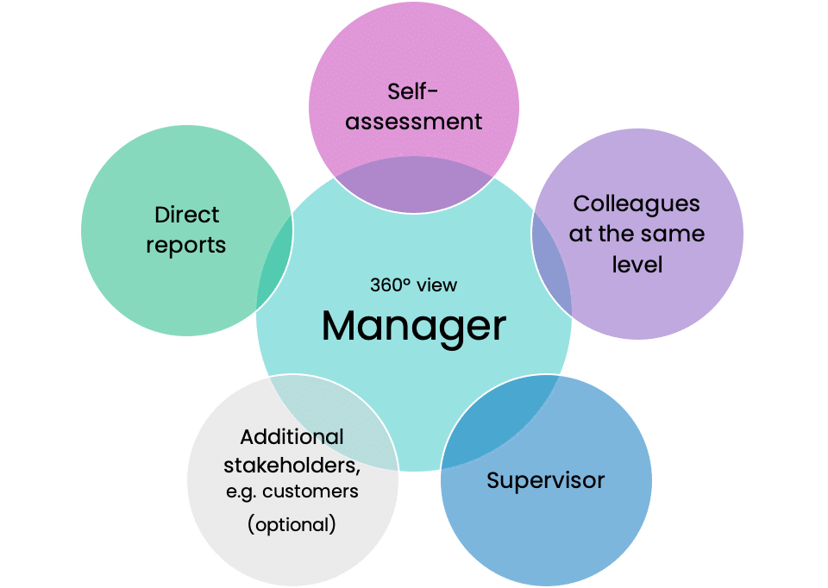
360 Degree Appraisal
A 360-degree assessment is a performance appraisal method that takes feedback and ratings from various sources like supervisors, staff members, peers, co-workers, and customers.
It prefers feedback from as many sources as available than a single source of truth. After collating all the feedback, the manager uses it to gauge the employee’s skills, strengths, and weaknesses.
Objectives of a 360-degree Performance Appraisal
SWOT Analysis
Change Management
Decision Making
Alignment of Goals and Potential
Overall development

Slide 19
Training: Meaning & Objectives
Teaching process for acquiring new skills and knowledge.
Enhances individual capabilities and competencies.
Occurs through structured instruction and practice.
Aims to improve performance and achieve desired outcomes.
Can be formal or informal, depending on context and goals.

Slide 20
Objective
Skill Development: Enhance expertise and proficiency.
Knowledge Acquisition: Acquire new insights and information.
Performance Improvement: Increase task efficiency and effectiveness.
Behavioral Change: Foster positive habits and attitudes.
Career Advancement: Facilitate growth and progression.
Team Building: Promote collaboration and synergy among members.
Adaptation to Change: Enable flexibility and resilience in dynamic environments.
Risk Mitigation: Enhance safety and minimize hazards associated with tasks.

Slide 21
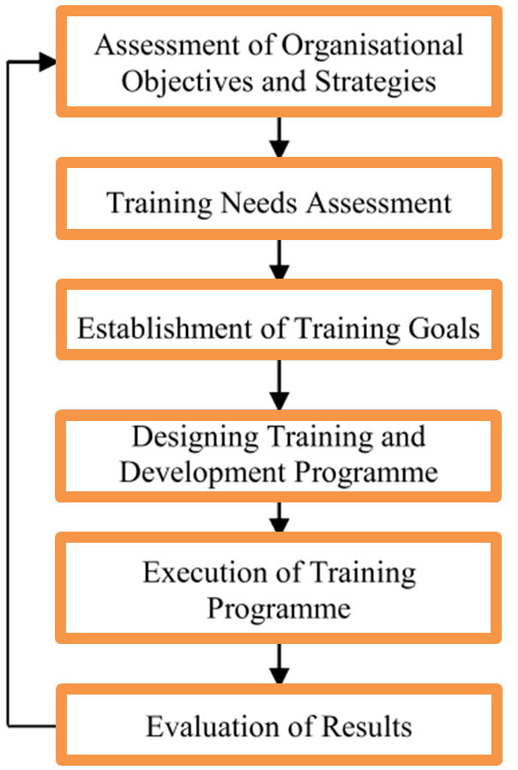
FORMULATION OF TRAINING PROGRAMME
Step 1 – Conduct an assessment
Step 2 – Set your training goals
Step 3 – Determine the best training methods
Step 4 – Create a plan
Step 5 – Invest in necessary resources
Step 6 – Create content that delivers
Step 7 – Measure and update training as needed

Slide 22
1. Conduct an assessment
Where does the business need to go?
Where are your employees currently?
What skills do they currently have?
What skills are they missing that can help them be more productive at their job?
What skills do they need to develop more?
2. Set your training goals
How will employee performance improve after the program?
How will the program improve employee retention?
How will ROI be measured?

Slide 23
3. Determine the best training method for your employees
New hire training
Ongoing employee training
Transitional training
Remote training?
In-person training?
Or a combination.
4. Create a plan
Who is this for?
What topics will be covered? I.e. What will they learn?
How will training be delivered?
Who will create the content?
What’s the timeline?
What’s the goal? (p.s. You just worked on this.)
What resources will we need?
How will we measure results?
What’s our budget?
How will we collect feedback on the program?

Slide 24
5. Invest in the necessary training resources and content
What resources are you going to need to develop an effective employee training program?
6. Create content that delivers
Creating content that team members love can be easy! Use engaging images, videos and even emojis to make it fun.
7. Deliver training, measure and update as needed
Create training flows, use quizzes to assess results and most importantly measure to see how the plan is delivering on the objectives first set out.
Don’t forget to get feedback employees too!
Measuring your training programs helps ensure you maximize your program’s chance of success.

Slide 25
TRAINING NEED ASSESSMENT
Determine desired outcomes.
Identify problems or specific points of pain.
Determine desired knowledge, skills and behaviors.
Set training timelines and priorities.
Identify specific gaps in knowledge, skills, or behavior.
Describe potential gap causes, in terms of both people and systems.
Set criteria for identifying possible solutions to close the gap.
Evaluate context (e.g., existing resources and lessons learned from past efforts).
Assess employee progress as a result of training regularly.

Slide 26
TRAINING METHODS
On-the-Job Training
Job Rotation
Coaching & Mentoring
Apprenticeship Training
Delegation of authority
Promotions and Transfers
Vestibule (Role-specific)
Job Instructional Training(JIT)
Off-the-Job Training
Roleplaying
Vestibule training
Classroom lecture & Discussions
Case study
Simulation Strategy
Transactional Analysis
Sensitivity Training (T-group)

Slide 27
Training Evaluation
Training evaluation is the systematic process of analyzing training programs to ensure that it is delivered effectively and efficiently. Training evaluation identifies training gaps and even discovers opportunities for improving training programs.

Slide 28
Benefits
identify issues and improve the overall processes of training programs;
analyze the effectiveness of training materials and other tools;
determine the needed leadership competencies to solve critical problems;
support continuous change in career development; and
assess the overall training experience of the participants.

Slide 29
EVALUATION OF TRAINING
1. Choosing the appropriate model
Kirkpatrick’s Four-level Model
This training evaluation process is used globally by businesses that aim to get a return on investment (ROI) through cost-effective and time-efficient training sessions. This model breaks down the evaluation process into 4 levels:
Level 1: Reaction – Assesses how the learner’s responded to the training. This is commonly measured with the use of a survey form given to the participants to complete after the training program.
Level 2: Learning – This level measures what participants have learned from the training. Short quizzes and tests are used in this level to measure the changes in participant’s knowledge and skills.
Level 3: Behavior – This assesses behavioral change from the participants as a result of training. This is measured through workplace observations, comparing before and after training behaviors.
Level 4: Results – The final step measures and evaluates the result of the training program against the organization or stakeholder’s expectations. It reviews whether participants of the training have met their learning objectives. Some metrics or factors organizations will be measuring are productivity, morale, quality, sales, efficiency, and customer satisfaction ratings.

Slide 30
EVALUATION OF TRAINING
The CIRO Model
The CIRO (context, input, reaction, and output) model evaluates the effectiveness of management training courses. It focuses on measurements taken before and after carrying out the training program. Similar to the other models, the training evaluation process is also broken down to 4 stages:
Stage 1: Context – This stage assesses the organization or business’s operational situation to identify and evaluate the training needs and objectives. In this stage, a training needs analysis is conducted to see which area of operations the organization is lacking. Once training needs are defined they are set to the following 3 levels:
The ultimate objective – this objective aims to eliminate organizational deficiencies like poor performance, low profit, low productivity, or poor customer service.
Intermediate objectives – these objectives require changes in employee’s work behavior in order to achieve the ultimate objective.
Immediate objectives – these objectives involve acquiring new skills and knowledge and even changing employee attitudes to change their behavior.
Stage 2: Input – In this stage, practitioners of the training evaluation gather information by analyzing available resources in the organization to determine the best choice of training technique or method to achieve training objectives.
Stage 3: Reaction – In this stage, feedback from the participants is collected. The information gathered from this stage is used to further improve the training program. Stage 4: Outcome – This stage evaluates the results of the training program. The outcome is measured on the following 4 levels:
The learner level
The workplace level
The team or department level
The business level

Slide 31
EVALUATION OF TRAINING
Phillips ROI Model
The Phillips ROI model evaluates the training program’s return on investment (ROI). This model basically emulates the scope and sequence of the Kirkpatrick’s Model, but with an additional step. The five levels of the model are as follows:
Level 1: Reaction – similar to the Kirkpatrick Model, the model starts with evaluating the participant’s reaction and satisfaction to the training program.
Level 2: Learning – this level measures the skills and knowledge gained by the participants
Level 3: Application and implementation – similar to the Kirkpatrick Model, this level measures whether the participants of the training program learned anything from training upon returning to the workplace. However, it improves that scope by determining whether an issue (if any) resides with the application of the learning or its implementation.
Level 4: Impact – in the Phillips model, instead of results it focuses on measuring the overall business impact of the training program. It is much broader compared to Kirkpatrick’s model as it identifies whether other factors aside from training affected the outcome.
Level 5: Return on investment (ROI) – This added level is designed to measure the ROI with the use of cost-benefit analysis to compare the monetary value of the business outcomes with the costs of the training program(s).

Slide 32
2. Determine indicators of training effectiveness
To effectively evaluate training programs, practitioners of the training program must first define the indicators of “effectiveness.” As a guide, practitioners or organizations should answer this guiding question: “In what sense will the training program be considered successful?”
Below are some examples of factors or indicators that can help in measuring training effectiveness:
New skills and knowledge
Learning experience
Employee happiness
Cultural impact
Efficiency impact
Financial impact

Slide 33
3. Choosing the right method and collecting data
Questionnaires – these are sets of questions commonly used for gathering statistical information from participants on a particular topic. This can be used as a tool when conducting surveys for trainees after the completion of the training program.
Interviews – this can be conducted either face-to-face or online. This method allows practitioners to delve deeper into the responses of the participants. Interviews can help provide practitioners with more valuable and detailed information on the employee’s experience with the training.
Focus groups – these are facilitated discussions among a small group of participants who underwent the same training program. This is helpful if the goal of the practitioners is to explore the participant’s insight and feelings towards the training and to gather some feedback on how the training can be improved.
Observation – this method is done by observing the participant’s behavioral change in a workplace setting. The practitioner or assigned evaluator will observe how they complete tasks or engage with processes and team activities.
Once a method has been selected, practitioners can proceed with collecting the data.
4. Analyze Data
The final step is to analyze the data collected and to document the findings of the performed training evaluation. The record of the training evaluation will be a critical component for future improvements in the organization’s approach to training programs.

